Slide 1

Unsupervised Learning and K-Means Clustering for Brown Dwarf Data Analysis NASA
Gokul Nookula
9/18/2024

Slide 2
Table of Content
Enhancements to the TelescopeML Project Using Unsupervised Learning
Implementing PCA and K-Means Clustering
Clustering Based on Wavelength Quartiles
Dimensionality Reduction with PCA
Interactive Data Exploration Tool
Benefits to TelescopeML Project
Future Improvements and Experiments
Summary and Acknowledgements

Slide 3
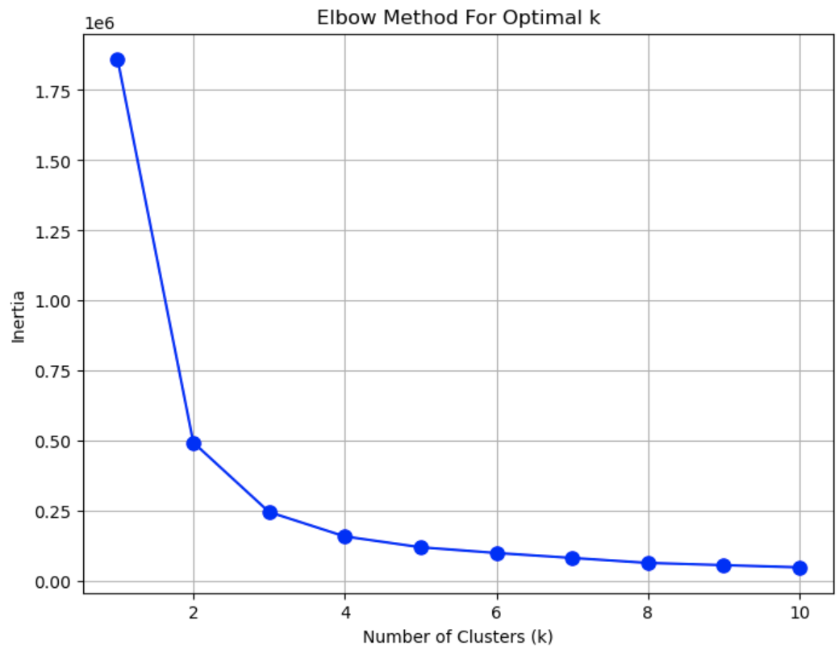
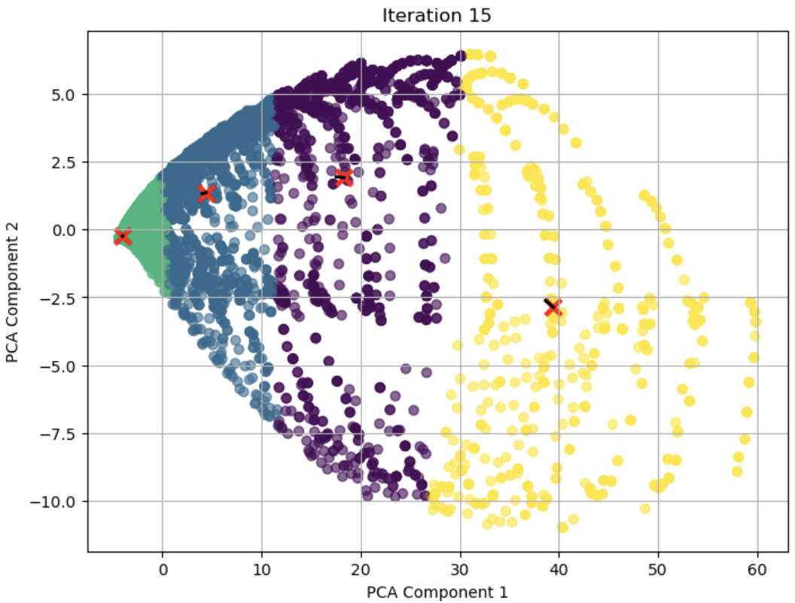
Enhancements to the TelescopeML Project Using Unsupervised Learning
TelescopeML Project Overview:
Focuses on analyzing astronomical data using machine learning techniques.
Processes spectral data from telescopes to understand celestial objects like brown dwarfs.
Provides insights into the physical properties (gravity, temperature, metallicity, and C/O ratio) of celestial objects.
Goals of Enhancements:
Implement unsupervised learning methods to identify hidden patterns in the data.
Use K-Means Clustering and PCA for dimensionality reduction and clustering of spectral data.

Slide 4
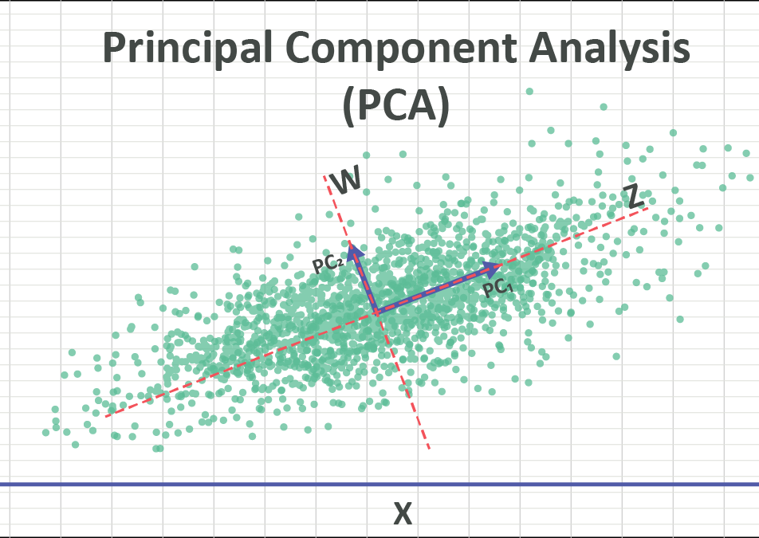
Implementing PCA and K-Means Clustering
Principal Component Analysis (PCA):
PCA helps reduce data dimensionality while retaining 95% of variance.
Helps in simplifying the dataset and making computations faster.
K-Means Clustering:
Groups similar data points into clusters based on spectral data.
Uses Euclidean distance to optimize centroids.
The custom run_kMeans function allows iterative clustering.

Slide 5

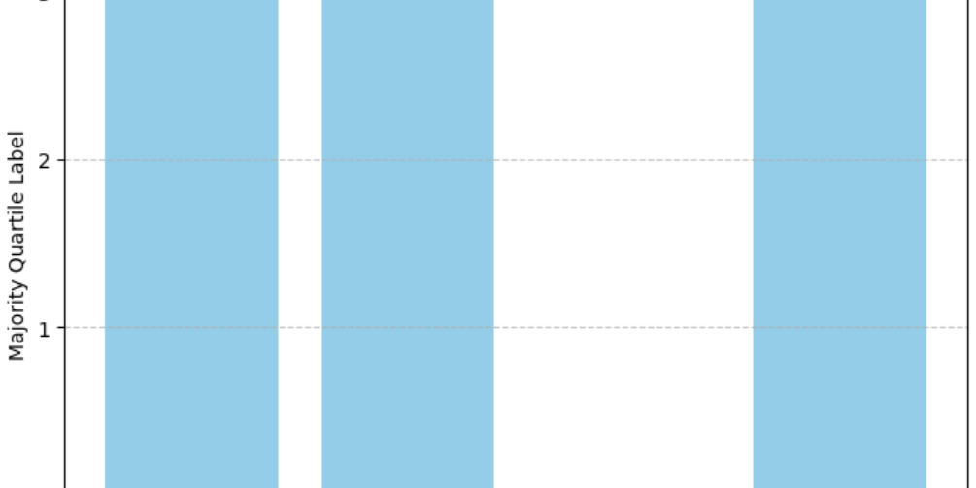
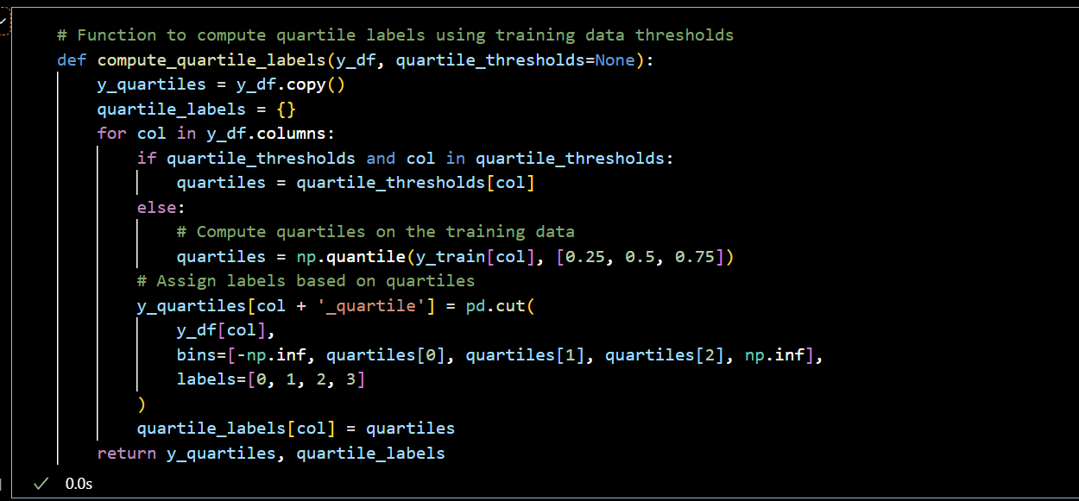
Clustering Based on Wavelength Quartiles
Explanation of how the data is divided into 4 quartiles based on spectral wavelengths.
Clustering is performed on subsets of the data where each quartile represents a different range of wavelengths.
Example: Lowest quartile represents data with highest wavelengths in the range [min, 1.1984], lower middle from [1.1984, 1.5388], etc.
This helps analyze patterns related to output variables such as gravity, temperature, and metallicity.

Slide 6
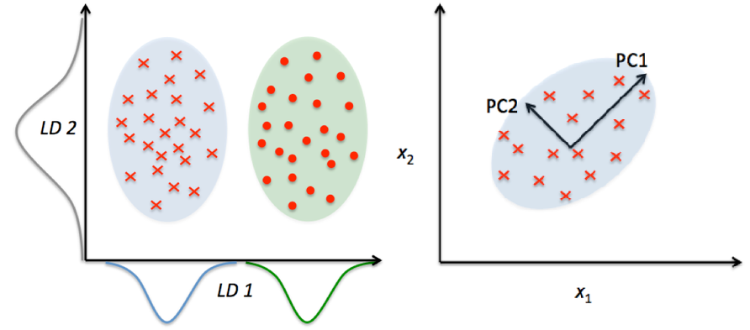
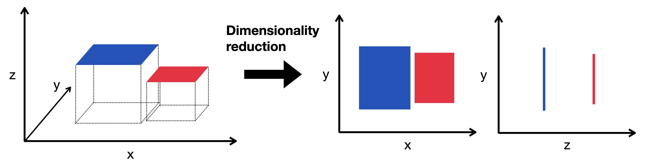
Dimensionality Reduction with PCA
PCA is used to reduce the number of features while preserving 95% of the data's variance.
The elbow method was employed to determine the optimal number of clusters (K).
PCA helps to process spectral data more efficiently, reducing computational time and improving clustering accuracy.

Slide 7
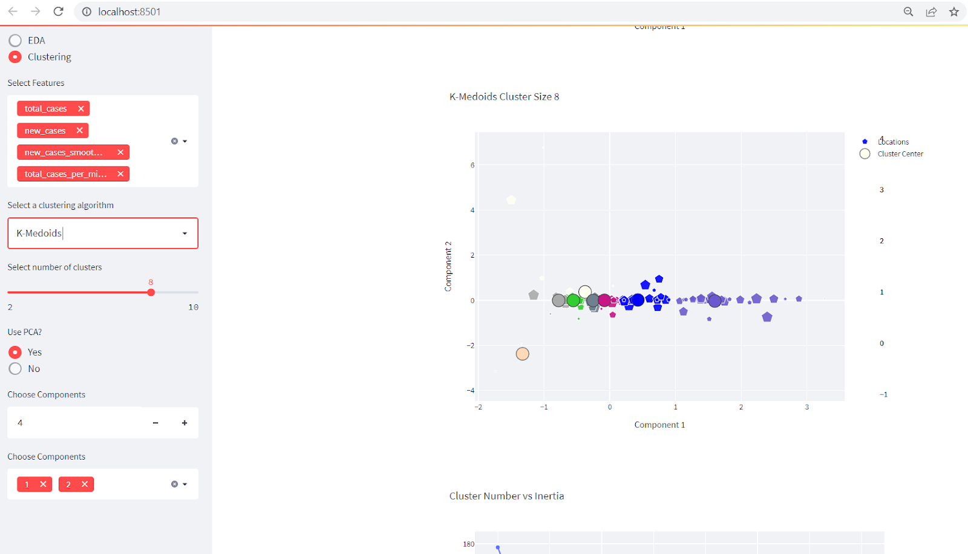
Interactive Data Exploration Tool
Functionality:
Allows users to adjust parameters such as the number of clusters and iterations.
Visualizes clustering results in real-time using Matplotlib.
Provides bar charts and clustering progress plots.
Proposed Enhancements:
Develop a GUI (e.g., using Streamlit or Flask) to allow users to explore data more interactively.
Users can visualize the clustering process and adjust the number of centroids or iterations.

Slide 8

Benefits to TelescopeML Project
Improved Analysis: Better understanding of data structure through dimensionality reduction.
Enhanced Usability: Interactive platform provides users with the ability to adjust parameters and visualize results.
Increased Efficiency: PCA helps to reduce the computational burden, making the system faster.

Slide 9

Future Improvements and Experiments
Algorithm Enhancements:
Explore hierarchical clustering or DBSCAN as alternative clustering methods.
Implement hyperparameter tuning for optimizing K-Means clustering.
Feature Expansion: Incorporate additional datasets or use advanced dimensionality reduction techniques like t-SNE.
User Interface Development: Implement a more user-friendly graphical interface for data exploration.
Model Evaluation: Test the models on new datasets and compare the performance with and without PCA.

Slide 10

Thank you
By Gokul Nookula

